Slide 1
Improvement of GK2A Convective Initiation Algorithm at NMSC/KMA
2021 Convection Working Group
7 April 2021
Hye-in Park (bhi1216@korea.kr),
Ki-Hong Park, Eunha Sohn, Jae-In Moon

Slide 2
Introduction
1
3
Result
2
Algorithm improvements
4
Summary & future works

Slide 3
Introduction

Slide 4
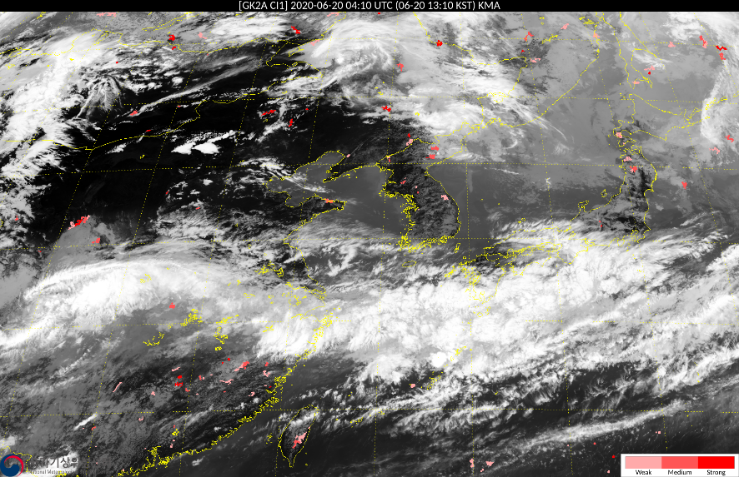
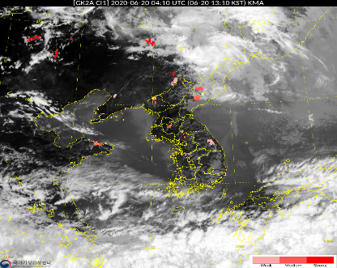
Algorithm Overview
Convective Initiation (CI)
ELA
Convective clouds cause heavy rainfall, hail, gusty wind and other severe weather
GK2A CI product identifies cumulus clouds that are likely to grow into convective clouds within 2 hours
LA
Name | Geographic Coverage | Horizontal Resolution | Refresh Time
Convective Initiation (CI) | Extended Local Area (ELA)/ Local Area (LA) | 2 km | 2 minutes
 | Temporal Coverage | Output | Measurements Accuracy
 | Day and night | CI Score | POD 70% FAR 40%

Slide 5
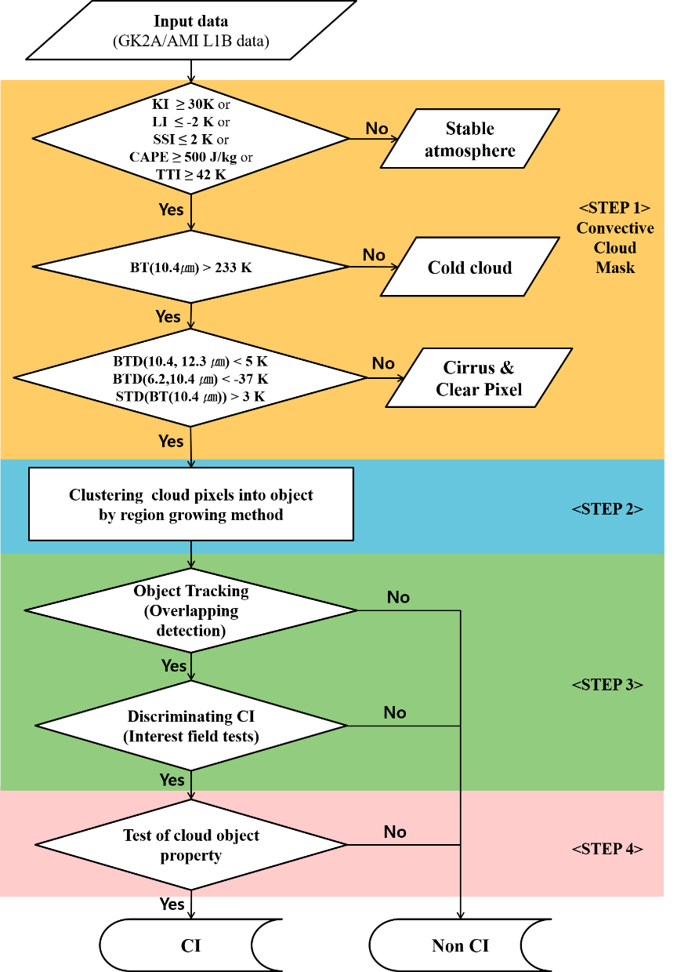
Data and method
Study data
(GK2A L1B) 0.64, 6.2, 8.6, 10.4, 11.2, 12.3, 13.3 μm
(GK2A L2) Atmospheric instability index (CAPE, LI, SSI, KI, TTI)
Method
1) Convective cloud mask (CCM)
- Cloud classification step to select CI candidate pixels
2) Clustering of cloud pixels
- Clustering candidate pixels classified from CCM
3) Determining CI objects
- CI determination through cloud physical properties and time trends
4) Test of cloud object property (post-processing)
- Removal of non-convective objects such as cirrus clouds and cloud edges

Slide 6
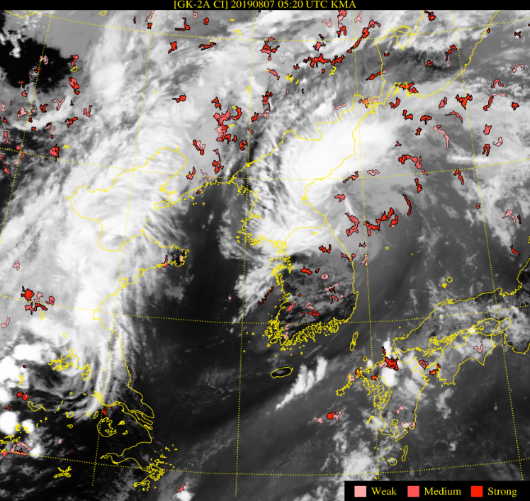
GK2A CI product Issues
The CI product detects any cloud object that is likely to develop into a convective cloud
Therefore, there are many false alarms because cloud edges, cirrus clouds, and non-convective clouds are detected.
Convective clouds occurring in spring and autumn are not detected
Convective Initiation
Non-convective clouds
Edge of cloud

Slide 7
Algorithm
Improvements

Slide 8
Algorithm improvements
1) Use of Total Totals Index(TTI)
(Original) Use of atmospheric instability indices CAPE, LI, KI, and SSI showing high accuracy in summer
(Improvement) Additional use of the TTI to detect convective clouds occurring in spring and fall
※ TTI = (T850-T500) + (Td850-T500)
2) Algorithm threshold update considering seasonal characteristics
Case of convective clouds from June to December 2019 (207 CI events)
Separated into March-May (Spring), June-September (Summer), and October-February (Autumn, Winter)
➔ Improved detection performance of convective clouds occurring in spring and autumn through 1) and 2)

Slide 9
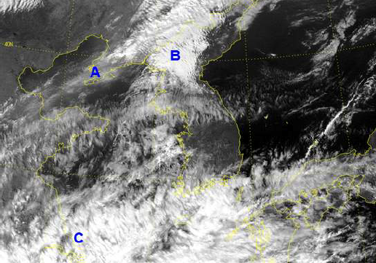
Algorithm improvements
3) Expansion of the cloud object size
(Original) The horizontal scale of clustered cloud objects is limited to less than 20km
(Improvement) Changed the horizontal scale from ~ 20km to ~ 25km
4) Reduced daytime false alarms using visible channel reflectivity
Reflectance of visible channel (0.64μm)
: High level clouds made up of ice have less reflectivity than lower level clouds made up of water
If the 0.64μm reflectance is less than 0.4, it is considered clear skies and cirrus clouds
VIS
IR
- A : High level cloud - B : Low level cloud - C : Convective cloud
➔ Improvement of false detection in cirrus and non-convective clouds through 3) and 4)

Slide 10
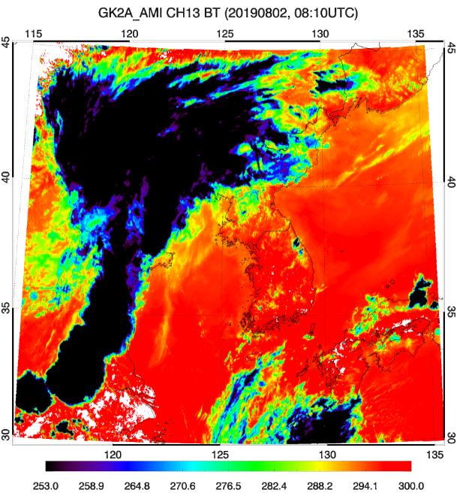
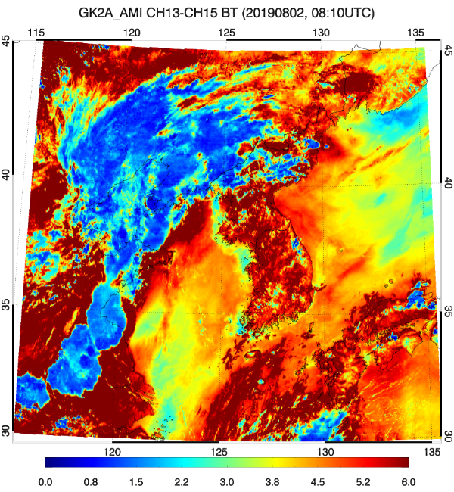
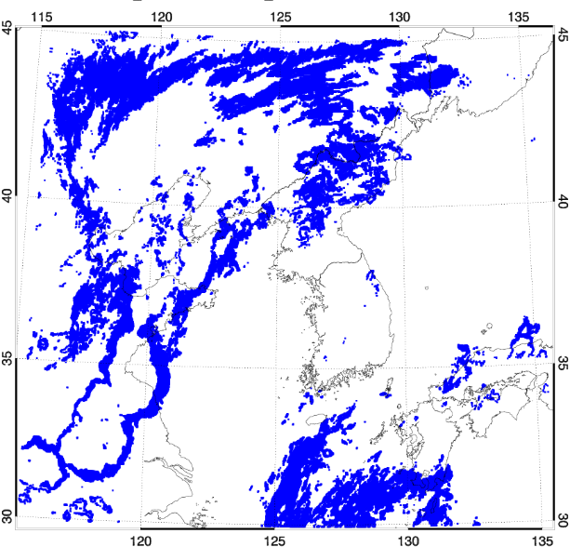
Algorithm improvements
5) Use of 10.4μm TB and split window technique
The edge of the cloud has a higher brightness temperature than the center of the cloud, and the phase and height of the cloud are similar to CI.
➔ Cloud edge removal using 10.4μm brightness temperature and split window technique (10.4-12.4 μm BTD)
10.4 μm Brightness temperature
10.4-12.4 μm BTD
Cloud edge area

Slide 11
Algorithm improvements
6) Elimination of false tracking considering the horizontal movement speed of convective clouds
The CI algorithm is calculated using the past object that overlaps the most with the current object, assuming that the vertical growth of clouds is greater than the horizontal movement of the convective cell
Removed when the distance between the center of the current object and the center of the past object is 25 km/10 min or more in consideration of the Meso-γ horizontal scale (2~20 km)
Purple dot: 10.4um BT minimum value position

Slide 12
Result

Slide 13
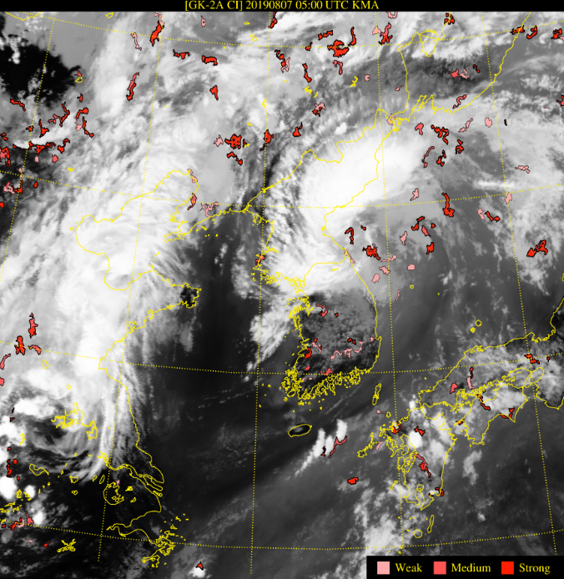
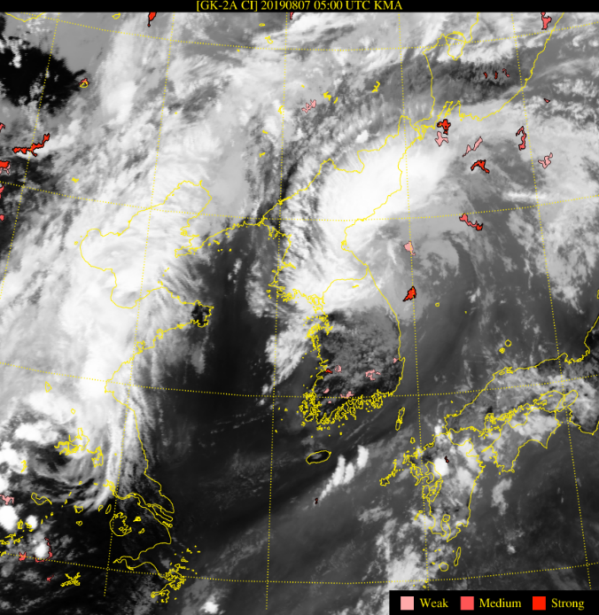
Result
7 August 2019
Convective clouds occurred between 04:00 UTC and 09:00 UTC ( :Hit, : False)
Reduce false alarms through removal of cirrus and cloud edges after improvement
Original CI
Improved CI

Slide 14
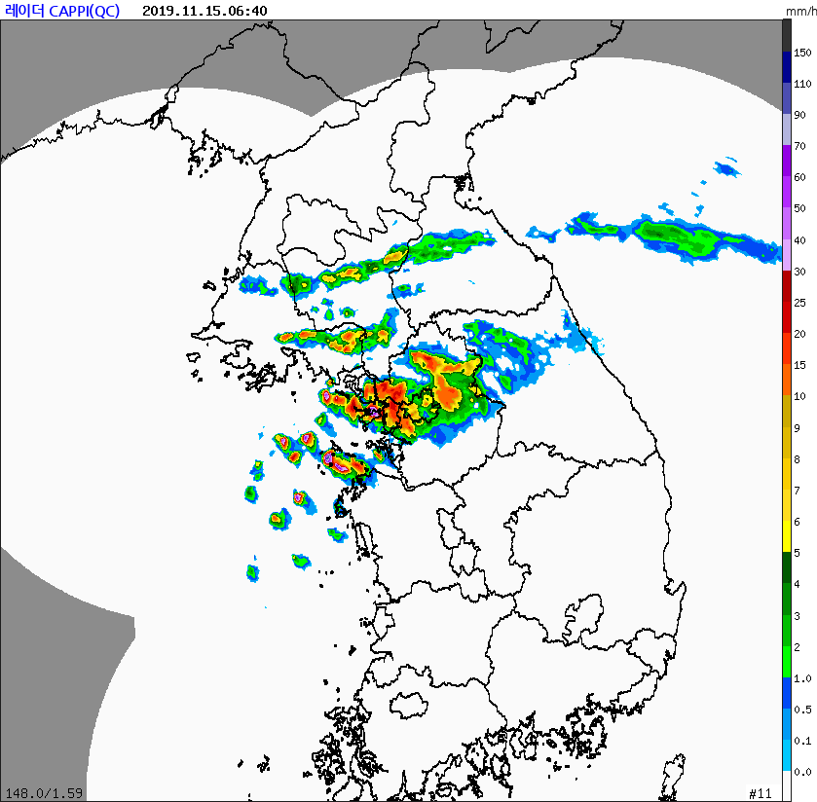
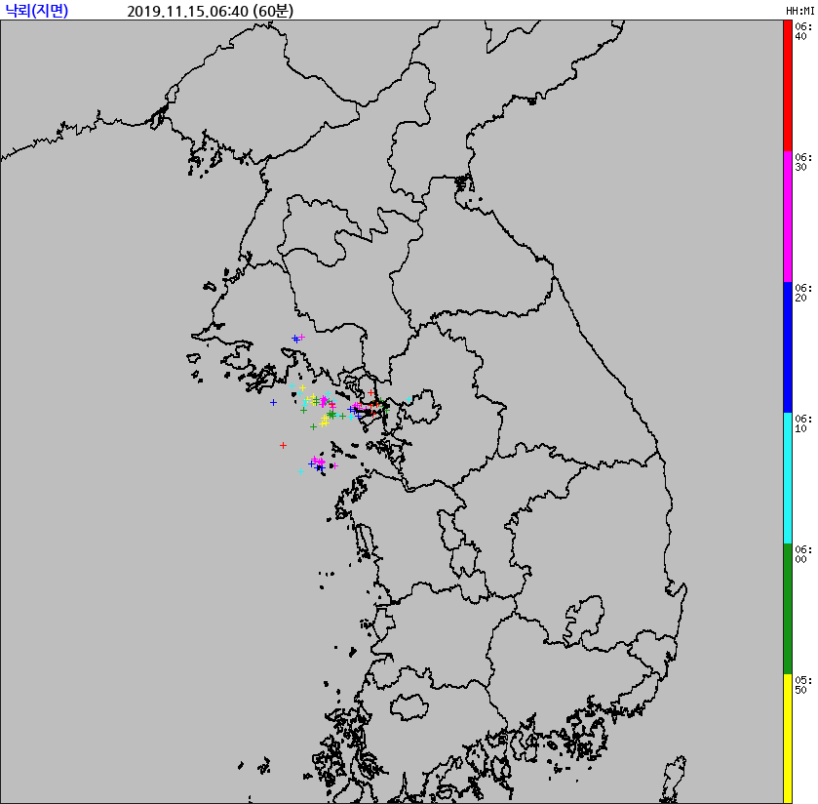
Result
14 November 2019
Original CI
Case of hail at around 21:40 UTC on November 14, 2019
(Original) CI not detected
(Improvement) CI detection success after using TTI and setting seasonal threshold
19:10 UTC
Radar data
Lightning data
21:40 UTC
21:40 UTC
Improved CI
19:10 UTC
: Hit
: Miss

Slide 15
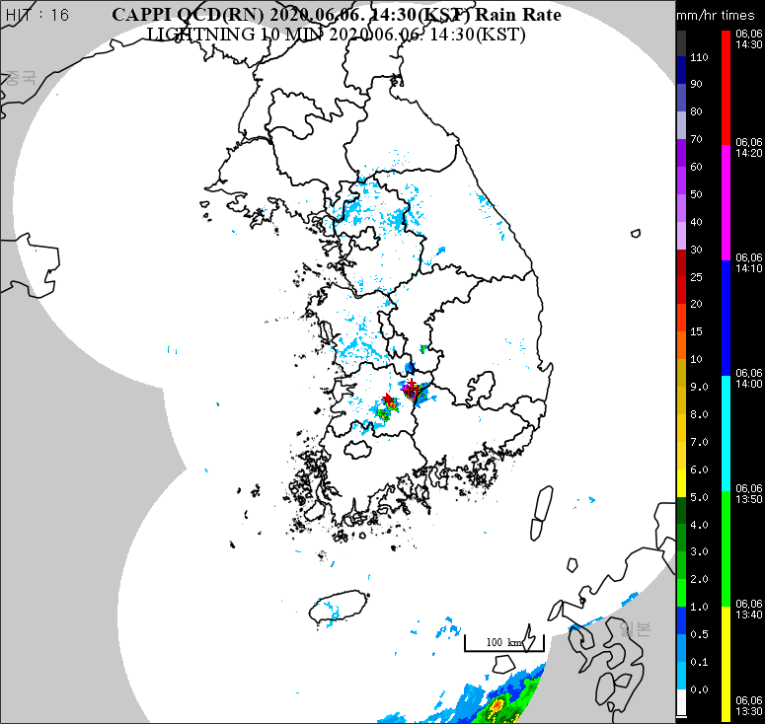
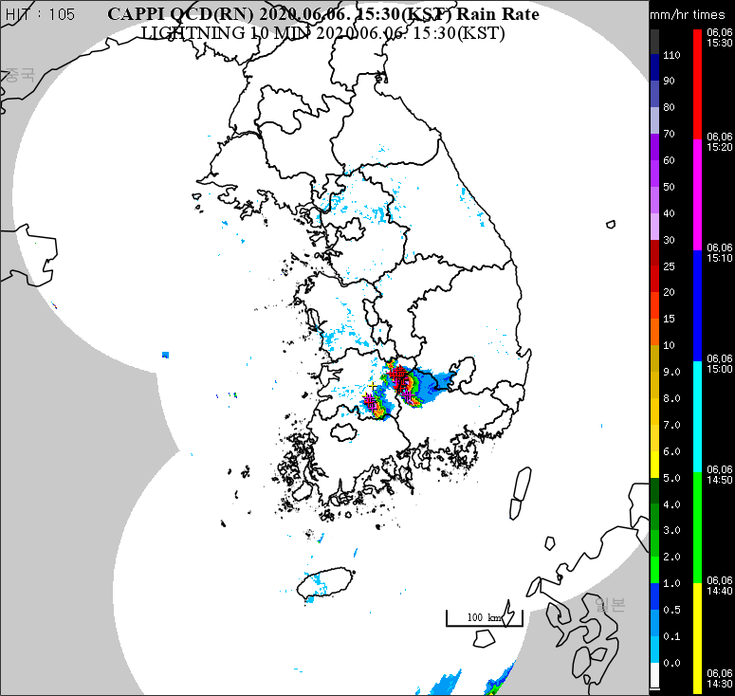
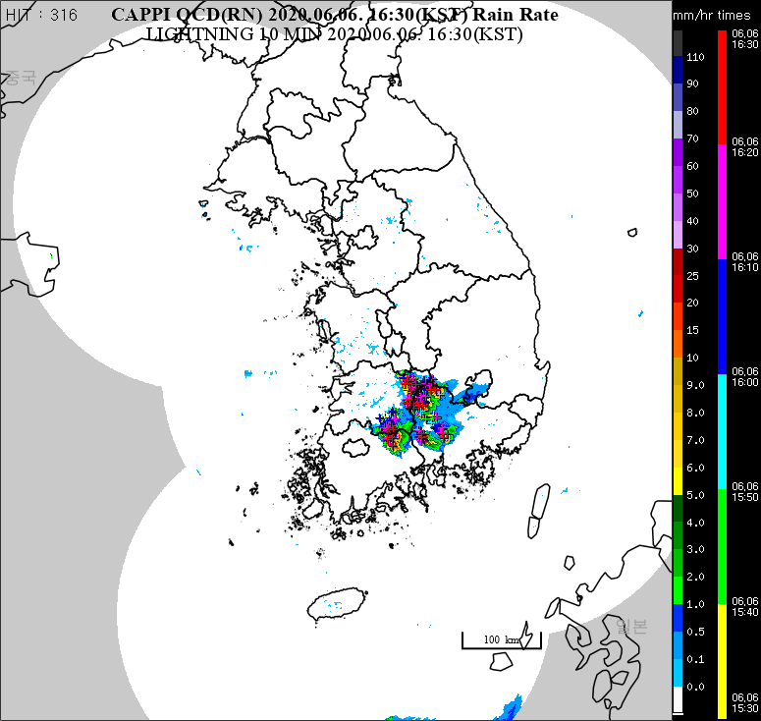
Result
6 June 2020
Case of hail from 07:00 UTC to 08:20 UTC on June 6, 2020
05:30 UTC
06:30 UTC
07:30 UTC

Slide 16
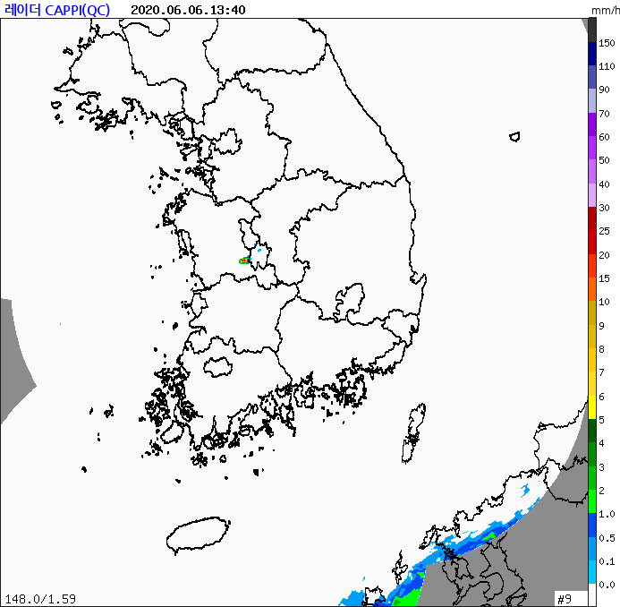
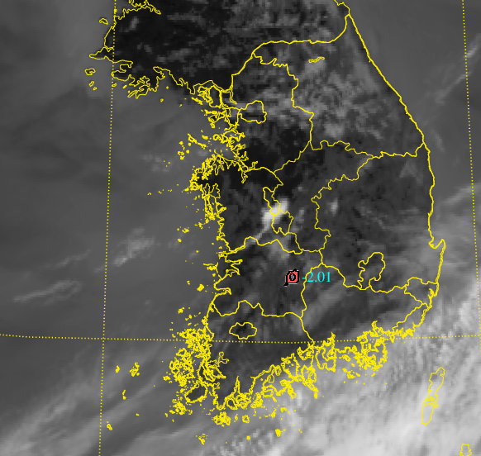
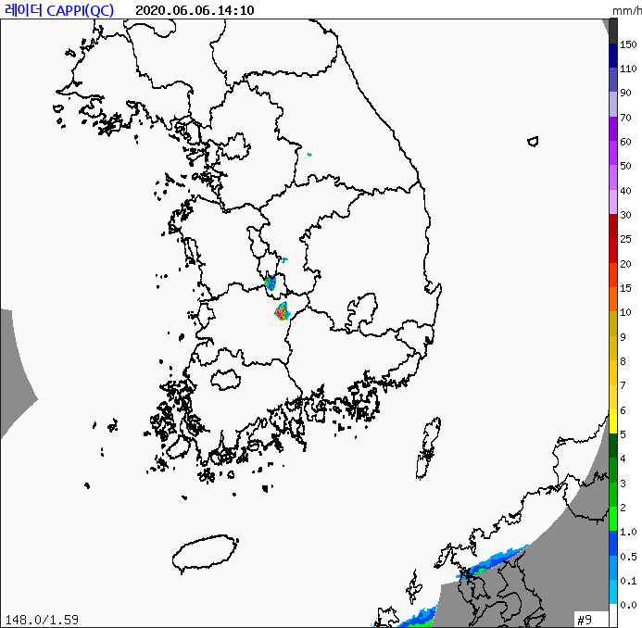
Result
6 June 2020
CI Forecast : 04:36 UTC ~ → Radar >35dBZ: 05:10 UTC ~
( :Hit, : False)
04:36 UTC
04:38 UTC
04:50 UTC
04:40 UTC
Original CI
04:36 UTC
04:38 UTC
04:50 UTC
05:10 UTC
Improved CI

Slide 17
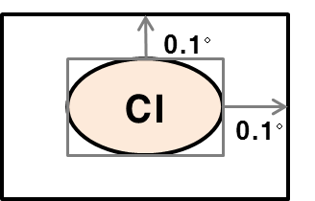
Validation
Data
Radar Constant Altitude Plan-Position Indicator (CAPPI) 1.5 km composite data
10.4 μm BT data → Use to remove mature clouds
Lightning data (ground data)
Method
Validation using radar and lightning data within 20 minutes to 2 hours after CI detection time
Contingency table |  | Was CI Forecast ?
 |  | Yes | No
Did CI Occur ? | Yes | Hit | Miss
 | No | False Alarms | Correct Negatives
POD (Probability of Detection) : hit / hit+miss
FAR (False Alarm Rate) : false / hit+false

Slide 18
Validation
Result
2019. 8. ~ 9. (10 cases)
Comparison of accuracy before and after algorithm improvement
⇒ FAR 17.80% reduction after algorithm improvement
 | POD |  | FAR
 | Before | After | Before | After
Total | 90.92% | 79.88% | 60.68% | 42.89%
CI cases in 2020
N | Date | POD | FAR | Mean lead time | Cause
1 | 2020-06-06 04~10 UTC | 87.87% | 50.14% | 31 min. | Low-level wind convergence, Thermal instability
2 | 2020-06-20 05~08 UTC | 89.64% | 43.21% | 36 min.
3 | 2020-06-21 03~07 UTC | 90.96% | 12.08% | 46 min. | Thermal instability
4 | 2020-06-27 05~08 UTC | 81.89% | 53.87% | 37 min. | Upper-level through
5 | 2020-07-16 04~07 UTC | 97.35% | 45.26% | 49 min. | Thermal instability
Total |  | 88.79% | 45.53%

Slide 19
Summary &
Future works

Slide 20
Summary
After algorithm improvement, false alarms were reduced in cloud edges, cirrus and non-convective clouds.
CIs occurring in spring and autumn were predicted by adding seasonal thresholds and atmospheric instability index TTI
This product will be useful for short-term forecasting as it predicts CI before lightning and radar events occur.
However, convective clouds that develop under cirrus and thick clouds are difficult to detect

Slide 21
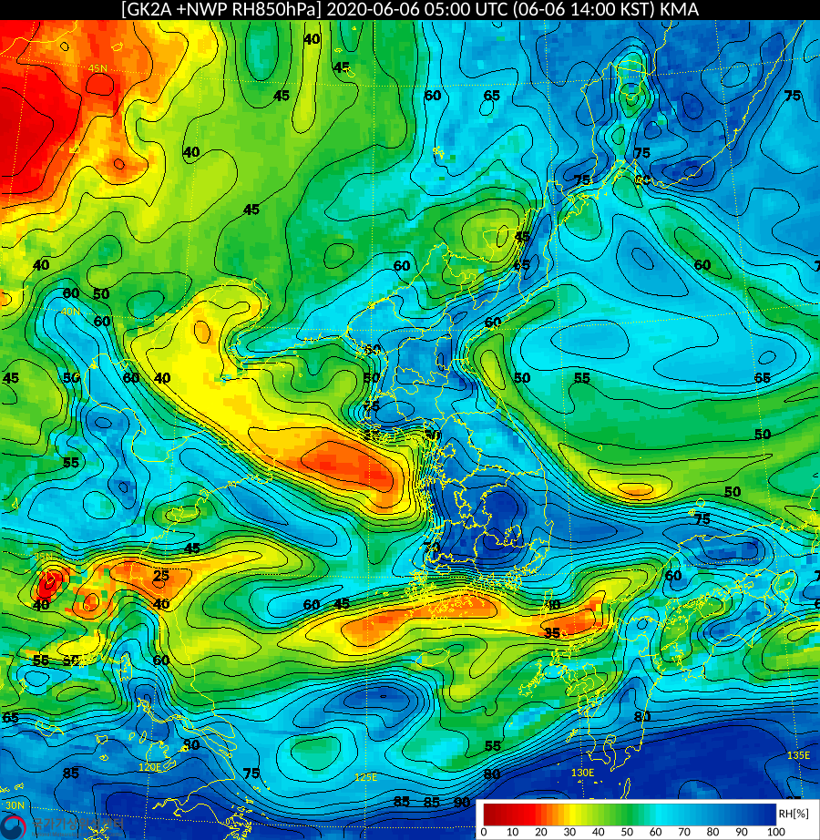
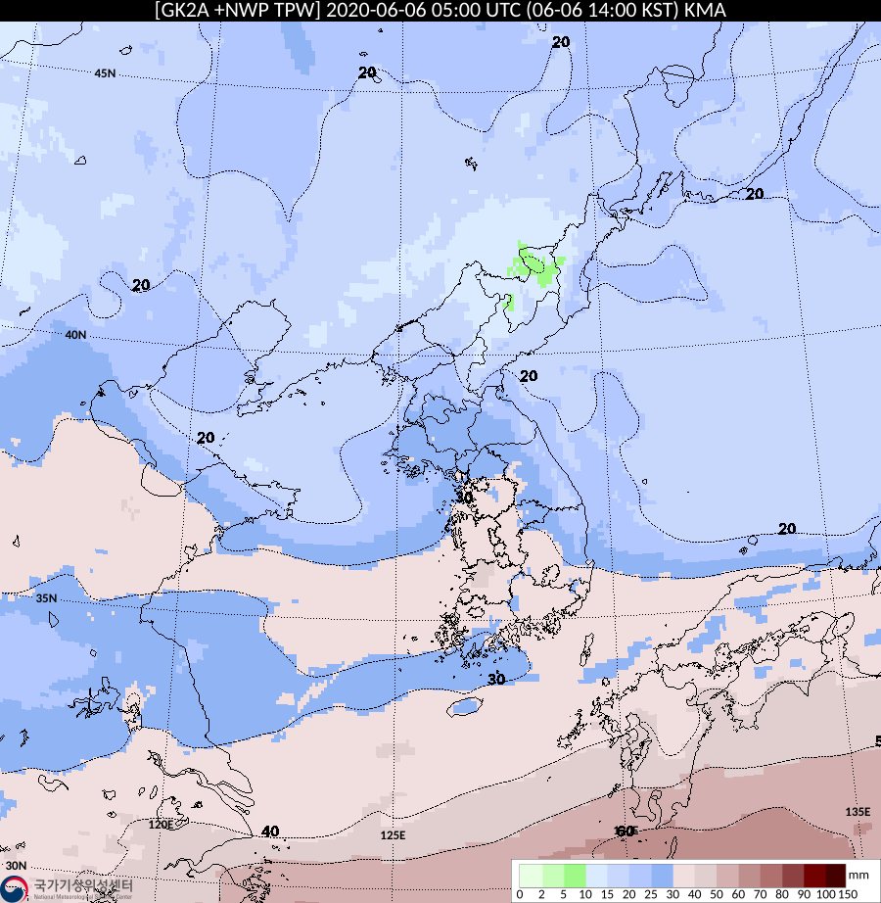
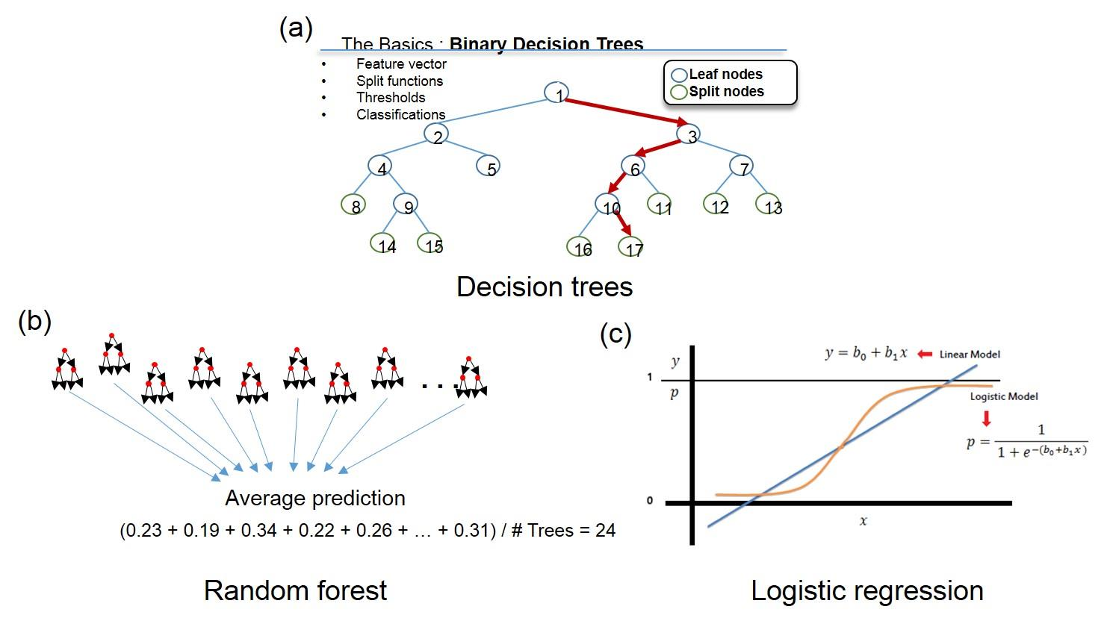
Future works
Use of temperature/humidity profile and precipitable water data to reinforce convective cloud mask
Development of machine learning based CI for calculating probabilistic prediction information
CI image improvement to increase user utilization
850hPa Relative humidity
TPW
Machine learning approach
05:00 UTC
05:00 UTC

Slide 22
Thank you !

Slide 23
Reference
Baek, S,-K., Choi, Y,-J., Chung, C,-Y., Cho, C,-H., 2006: The Characteristics and Predictability of Convective System Based on GOES-9 Observations during the Summer of 2004 over East Asia, Atmosphere, 16(3), 225-234.
Bins, L. S. A., Fonseca, L. G., Erthal, G. J., and Ii, F. M., 1996: Satellite imagery segmentation: a region growing approach. Simpósio Brasileiro de Sensoriamento Remoto, 8, 677-680.
Inoue, T., 1985: On the temperature and effective emissivity determination of semi-transparent cirrus clouds by bi-spectral measurements in the 10μm window region. Journal of the Meteorological Society of Japan. Ser. II, 63(1), 88-99.
Lakshmanan, V., Hondl, K., and Rabin, R., 2009: An efficient, general-purpose technique for identifying storm cells in geospatial images. Journal of Atmospheric and Oceanic Technology, 26(3), 523-537.
Mecikalski, J. R., and Bedla. K. M., 2006: Forecasting convective initiation by monitoring the evolution of moving cumulus in daytime GOES imagery. Monthly Weather Review, 134(1), 49-78.
Okabe, I., Imai, T., and Izumikawa, Y., 2011: Detection of rapidly developing cumulus areas through MTSAT rapid scan operation observations. Meteorol. Satell. Cent. Tech. Note, 55, 69-91.
Siewert, C. W., Koenig, M., and Mecikalski, J. R., 2010: Application of Meteosat second generation data towards improving the nowcasting of convective initiation. Meteorological Applications, 17(4), 442-451.
Walker, J. R., and Mecikalski, J. R., 2011: NOAA NESDIS center for satellite applications and research algorithm theoretical basis document convective initiation.
Walker, J. R., MacKenzie Jr, W. M., Mecikalski, J. R., and Jewett, C. P., 2012: An enhanced geostationary satellite–based convective initiation algorithm for 0–2-h nowcasting with object tracking. Journal of Applied Meteorology and Climatology, 51(11), 1931-1949.

